Slide 1
Crowd Flow Monitoring with NX ToolKit
SORNAM THIYAGARAJAN
RAGAVI MARIMUTHU

Slide 2
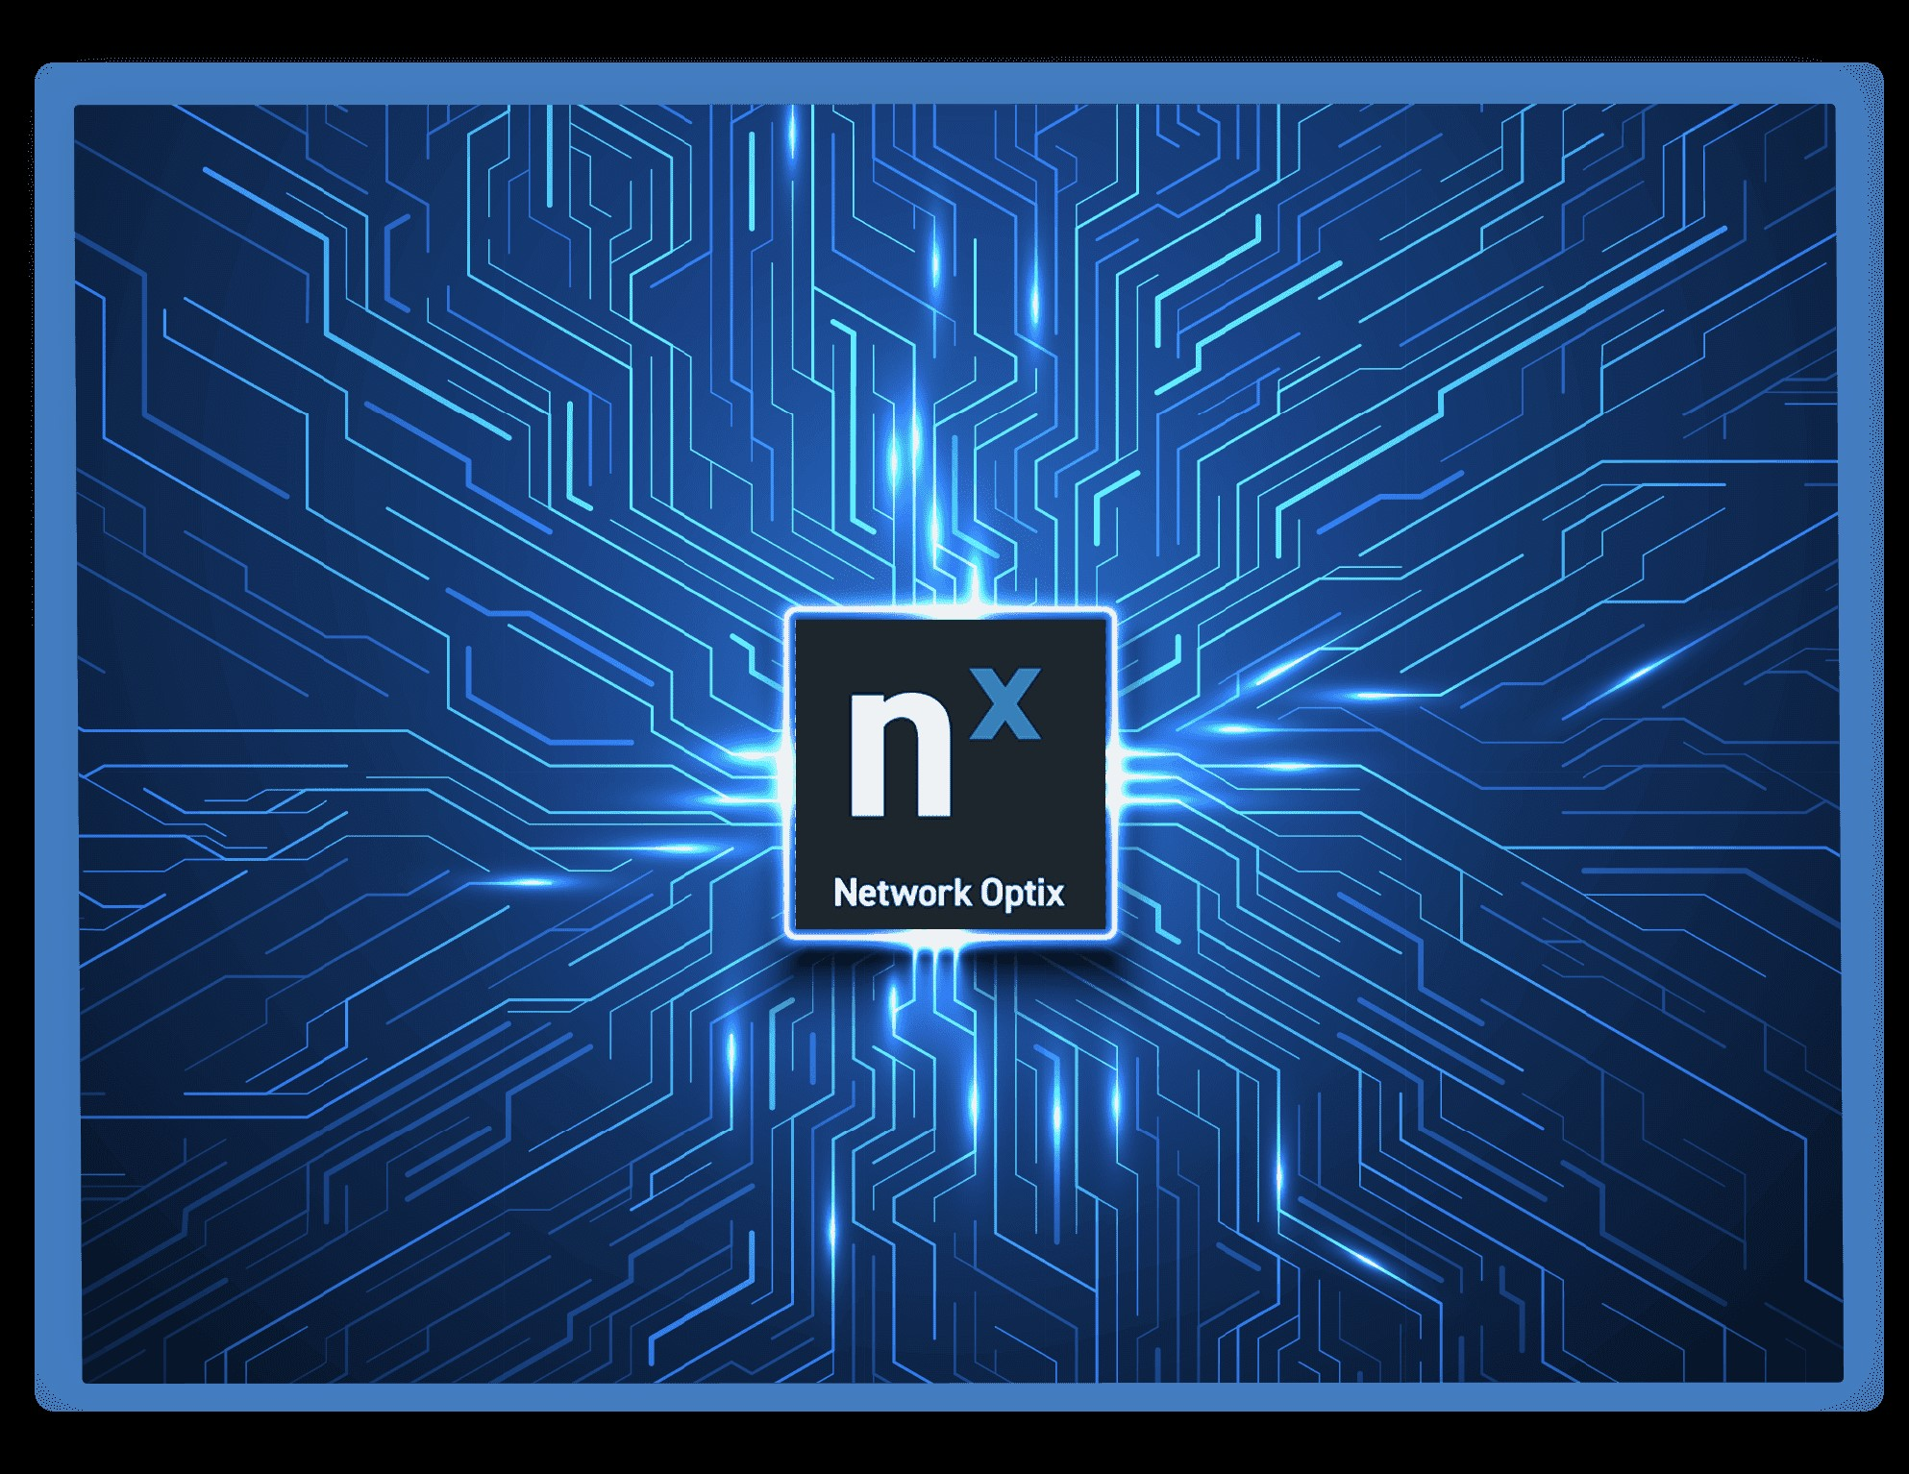
Problem Statement
As Urban populations continue to grow and public events become larger and more frequent, managing crowds in real-time to ensure safety, efficiency, and a positive experience becomes increasingly challenging. Overcrowding, misdirected foot traffic, long wait times, and inadequate emergency response systems can result in security risks, logistical inefficiencies, and reduced public satisfaction. Moreover, the inability to implement proactive, tailored solutions worsens these issues, potentially leading to dangerous situations such as stampedes, accidents, or delayed emergency interventions.
Mitigating Technique
To resolve the challenges outlined above, the development of the Real-Time AI-Powered Video Solutions NX Toolkit and NX AI Manager will revolutionize crowd management, enhancing safety and efficiency while ensuring a positive public experience.

Slide 3
Problem Solving Approach – User Interaction
User Flow: The user engages with the NX Mobile App by first downloading and logging in. After that, they configure their live location with initial setup and navigate through the interface to carry out essential tasks with the Nx METADATA SDK Toolkit, such as:
Managing Crowd Density by utilizing the Identity Recognition feature.
Finding Optimal Routes for their location with the help of the Traffic Management feature.
Allocating Resources for medical needs and security teams by leveraging Behavioral Analytics.
Accessing Live Video Streams through the Identity Recognition feature.
Receiving Safety Alerts (for events like stampedes, accidents, earthquakes, snowfall, cold waves, etc.) via Behavioral Analytics.

Slide 4
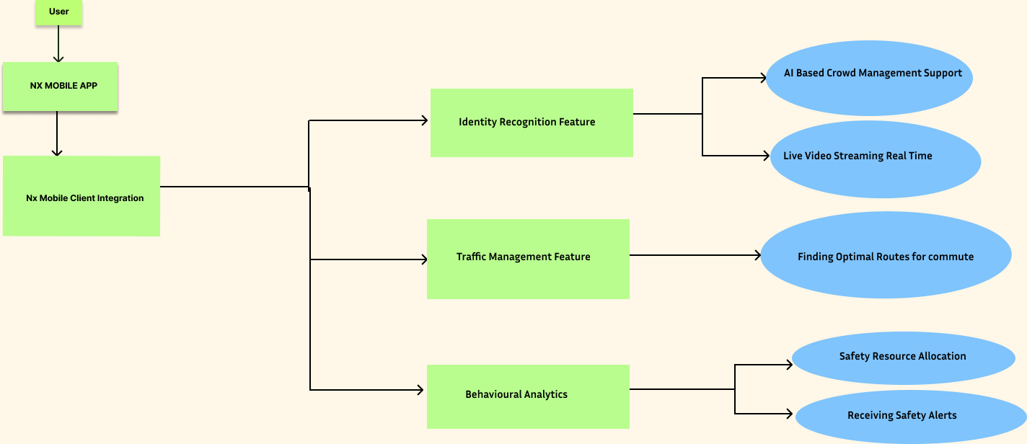
User Experience Overview

Slide 5
Technical Solution – Signal Processing Pipeline Breakdown
Step1: Data Collection
Input Signals:
1. Video Feeds ( via Surveillance Camera, Drones or Sensors)
2. Environmental Data (e.g. temperature at the specified location, crowd density and traffic)
3. Social Media/Event Data (tweets,posts or Emergency Alerts)
4. Geospatial Data (GPS, maps, location tracking)
Step2: Pre-Processing
Noise Reduction:
1. Initial cleaning and noise reduction on video streams(e.g. Blurring out irrelevant background).
Signal Normalization
1. Standardizing formats for uniformity (e.g. resizing videos, converting various sensor outputs into compatible formats)

Slide 6
Technical Solution – Signal Processing Pipeline Breakdown
Step3: AI/ML Model Application
Model1: Computer Vision for Crowd Management/Detection
Model Reference: Convolutional Neural Network(CNN) for Real-Time Video processing to detect crowd density and movement pattern for clear observation.
NX Toolkit Reference: Using Video Source SDK pattern for Integrate live or recorded video sources I/O and audio devices to understand crowd system for displaying,analyzing and discovering from video source.
NX Integration SDK link: https://meta.nxvms.com/docs/developers/knowledgebase/196-vmsname-server-plugin-sdk-c?__hstc=160140578.723c25cb13a1a7315258fde63f0fde91.1737484603488.1737734072075.1737736112733.3&__hssc=160140578.4.1737736112733&__hsfp=2464379515
Goal : Detect number of people, identify crowd density, and analyze movements.

Slide 7
Technical Solution – Signal Processing Pipeline Breakdown
Step3: AI/ML Model Application
Model2: Time Series Forecasting -Traffic Management
Model Reference: Recurrent Neural Network(RNN) for particularly predicting traffic in dynamic and time-dependent environments
NX Toolkit Reference: Using Metadata SDK enables seamless integration of object-oriented video analytics into Nx EVOS
NX Integration SDK link: https://meta.nxvms.com/docs/developers/knowledgebase/196-vmsname-server-plugin-sdk-c?__hstc=160140578.723c25cb13a1a7315258fde63f0fde91.1737484603488.1737734072075.1737736112733.3&__hssc=160140578.4.1737736112733&__hsfp=2464379515
Goal : Predict Traffic Congestion, Improved Public Transportation, Fewer Accidents, Better Decision Making

Slide 8
Technical Solution – Signal Processing Pipeline Breakdown
Step3: AI/ML Model Application
Model3: Safety Alert Detection–Behavioral Analytics
Model Reference: K-Means Clustering to detect unusual crowd behaviour that could signify an emergency(e.g.stampedes,fights or sudden urges)
NX Toolkit Reference: The Nx Metadata SDK can also used to integrate with deep learning solutions which detect and analyse human behaviour e.g. people counting, heat mapping, queue management,falldetection and even violence detection
NX Integration SDK link: https://meta.nxvms.com/docs/developers/knowledgebase/196-vmsname-server-plugin-sdk-c?__hstc=160140578.723c25cb13a1a7315258fde63f0fde91.1737484603488.1737734072075.1737736112733.3&__hssc=160140578.4.1737736112733&__hsfp=2464379515
Goal : Mobile App push Notifications, Dynamic Signage.

Slide 9
Hardware Integration
1.Mobile Devices (Smartphones/Tablets)
1.Operating System – Android and iOS (for compatibility across mobile platforms)
2.Processor – Multi-Core Processors(e.g. Snapdragon or A-Series chips) for smooth real-time video streaming and multitasking
3.Memory – Minimum of 4GB RAM for handling multiple video feeds and large amount of data simultaneously
4.Storage – 64GB or higher to store application data, video history and user preferences
5.Connectivity – 4G/5G,Wi-Fi, and Bluetooth support for seamless connection to the cloud, cameras and IoT devices.
2.Cameras and IoT Devices
1.Camera Type – IP Cameras with high-definition(HD) or 4K resolution, offering clear image quality for crowd monitoring.
2.Sensors – IoT sensors for monitoring crowd density, temperature and air quality.
3.Servers/Cloud Infrastructure
1.Cloud Storage– A secure cloud infrastructure for storing and processing video feeds, event log and analytics.
2.Server Specifications – High-performance servers with ample storage (e.g. SSD's) powerful CPUs and strong internet connection to support real-time data processing

Slide 10
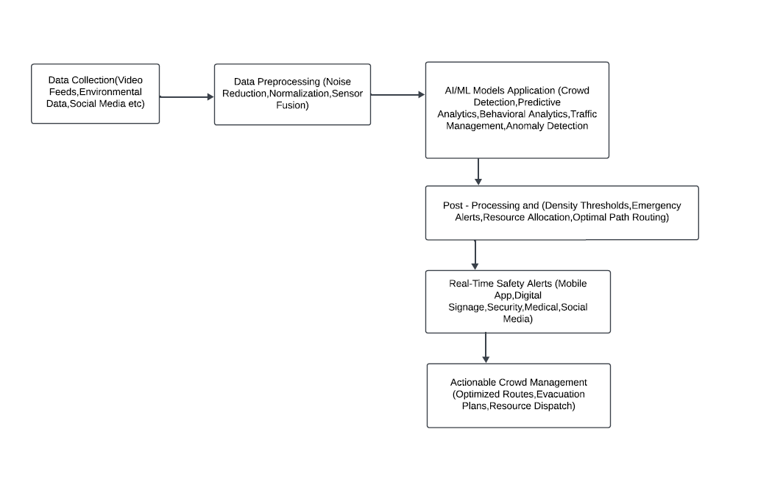
Visual Representation

Slide 11
Why Our Idea is Unique:
Our solution leverages AI-powered real-time video analytics and crowd density management in a way that combines advanced technology with user-centric design. Unlike existing systems, which primarily focus on video surveillance or static crowd control methods, our platform integrates dynamic crowd flow management with live video streaming, precautionary alerts, and interactive guidance for visitors. Here's why it's unique:
1. AI-Driven Crowd Density and Movement Analysis
2. Smart Navigation and Personalized User Experience
3. Comprehensive Emergency Response Integration
4. Sustainability and Efficiency in Venue Management.

Slide 12
How It Differs from Existing Solutions
1. Integrated Crowd Management with AI and Real-Time Feedback:
Most current systems either focus on static surveillance or rely on manual intervention for crowd management. Our solution integrates real-time AI analytics, allowing dynamic, automated decisions to be made in the moment.
Existing systems often fail to provide personalized user guidance (e.g., optimal routes for visitors), while our app proactively guides individuals and groups.
2. Proactive Risk Management:
Many crowd management solutions focus solely on detecting incidents after they occur (e.g., in case of accidents or emergencies). Our solution provides precautionary alerts based on predictive data, preventing incidents before they escalate.
AI predictions allow event organizers to manage crowds more effectively and avoid situations like overcrowding, stampedes, or unsafe conditions in real time.
3. Sustainability-Focused Analytics:
Unlike most traditional solutions that overlook sustainability, our system uses data insights to help venues optimize energy usage, space management, and even waste collection, promoting sustainable practices and reducing operational costs.

Slide 13
Conclusion
In conclusion, the integration of AI and ML models with the NX Toolkit offers a groundbreaking solution for real-time crowd management, enhancing the safety, efficiency, and experience of visitors in public spaces. By leveraging advanced AI algorithms and machine learning models, we can analyze and predict crowd behavior, optimize venue layouts, and provide real-time alerts and guidance for both visitors and management teams.
With the NX Toolkit as a backbone, we can:
Predict and prevent potential crowd-related incidents (e.g., overcrowding, stampedes, accidents) before they occur.
Optimize crowd flow through AI-driven insights, ensuring that visitors always have access to the most efficient and comfortable routes.
Offer personalized user experiences with real-time navigation, event updates, and emergency response notifications via mobile apps.
Enhance sustainability in venue management by providing data-driven recommendations on resource usage, waste management, and energy consumption.
The use of AI and ML models with the NX Toolkit ensures that our solution is not only adaptive and dynamic, but also scalable, providing long-term value for both venue operators and visitors. This innovative approach is set to redefine the standards of public space management, making environments safer, smarter, and more sustainable for everyone involved.

Slide 14


